Slide 1


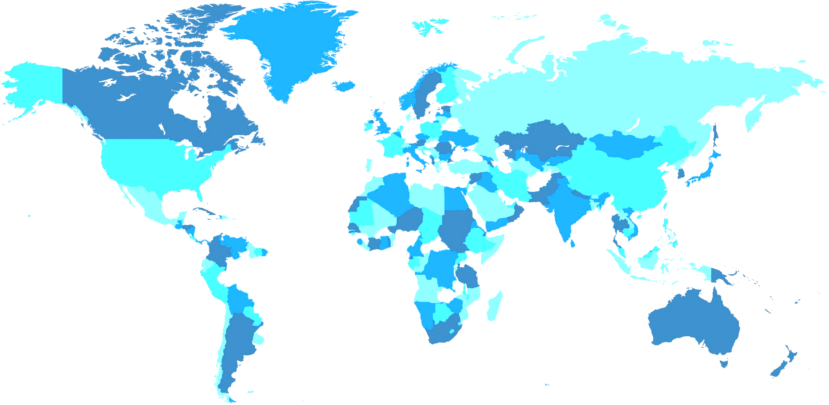
MENA Database and Query
Think Tanks and Civil Societies Program
Lauder Institute
University of Pennsylvania

Slide 2

Think Tanks and Civil Societies Program Lauder Institute
Introduction
The Middle East and North Africa Team of Summer 2017 attempted to create a database and query that would analyze the think tanks in their region and provide statistics and graphs.

Slide 3
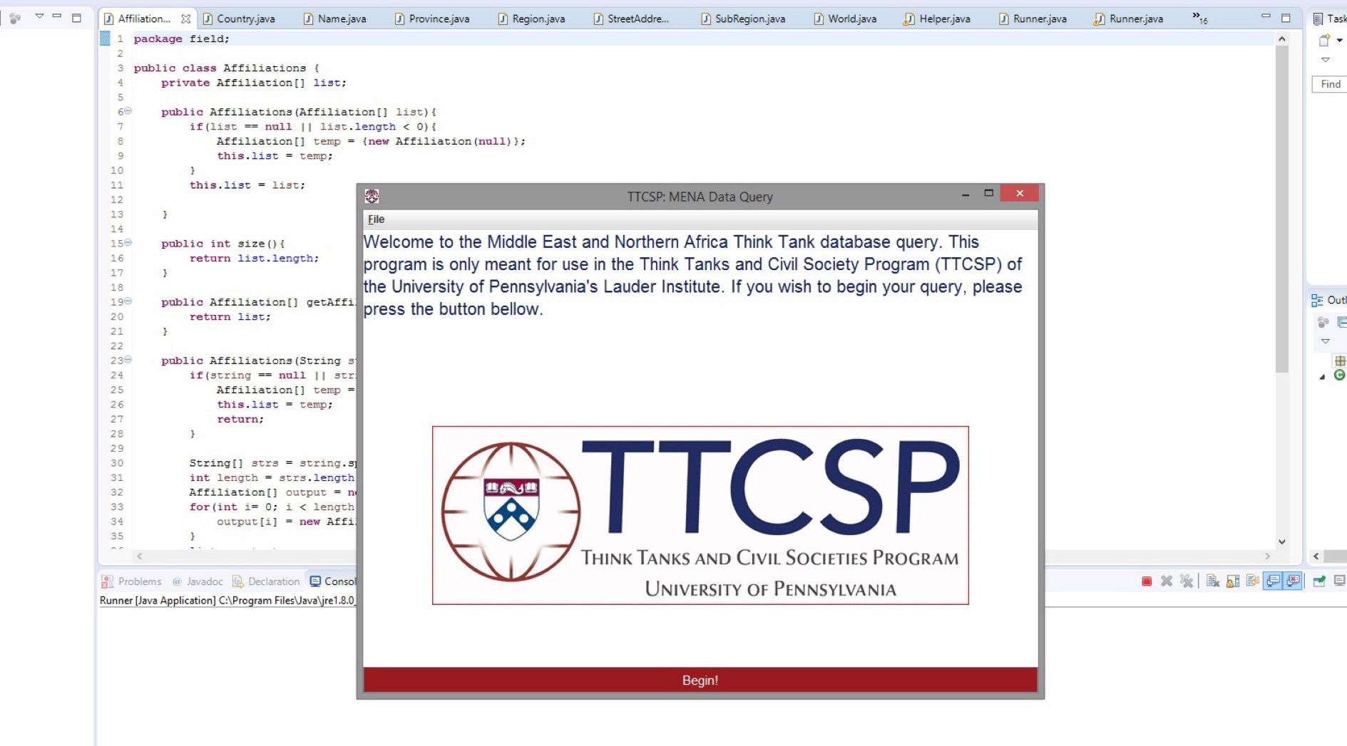
Think Tanks and Civil Societies Program Lauder Institute

Slide 4
Think Tanks and Civil Societies Program Lauder Institute
MENA Database and Query
Takes in a formatted .csv file with specific information from each think tank
Creates a database of the aforementioned information
Displays list of think tanks included in database
Queries may be performed to search specific regions, or search for think tank ideologies or affiliations and provides counts for each

Slide 5
Think Tanks and Civil Societies Program Lauder Institute
MENA Database and Query
I will provide three examples of queries the program was built to create.
These charts were created by the MENA Research team manually. Although the program had the potential to create each one of these charts.

Slide 6
Think Tanks and Civil Societies Program Lauder Institute
Inactive Think Tanks in MENA Region
Example 1
Source: Middle East and North Africa Presentation

Slide 7
Think Tanks and Civil Societies Program Lauder Institute
Example 2
North Africa
Source: Middle East and North Africa Presentation

Slide 8
Think Tanks and Civil Societies Program Lauder Institute
Example 3
Global Inactive Think Tanks
Source: Middle East and North Africa Presentation

Slide 9
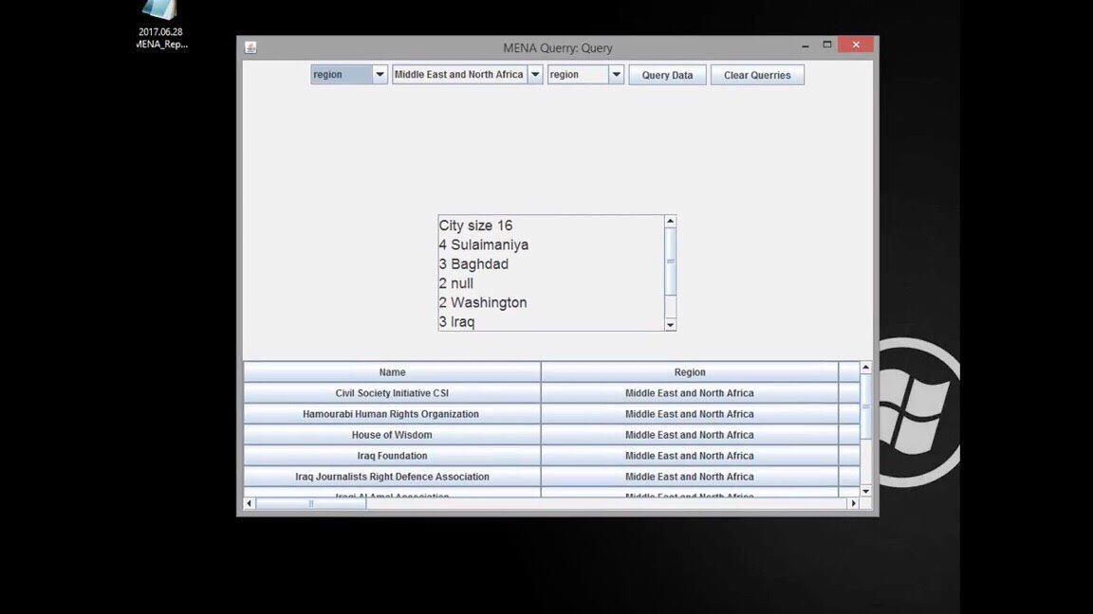
Think Tanks and Civil Societies Program Lauder Institute
Working Demo

Slide 10
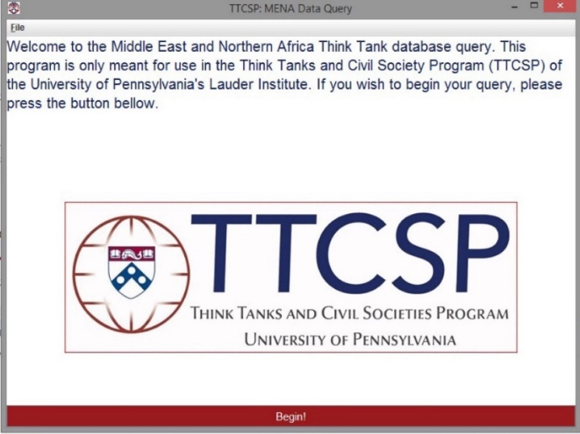
Think Tanks and Civil Societies Program Lauder Institute
MENA Database and Query
Before development ended
The final program was in the process of being readjusted to look more visually appealing.
The program was being fed invalid data, so we were in the process of correcting it.

Slide 11

Think Tanks and Civil Societies Program Lauder Institute
Two Prototype Videos
https://www.youtube.com/watch?v=TwLmrtSFLKs
https://www.youtube.com/watch?v=ZnbL5v1WViw

Slide 12
Think Tanks and Civil Societies Program Lauder Institute
Provided Documents
We have provided a copy of three versions of the program, and descriptions of each for further implementation.
The working MENA Database and Query Program
Link: https://drive.google.com/file/d/0BxOx78K0xdqOZkN3U3BTc0JMMDQ/view

Slide 13
Think Tanks and Civil Societies Program Lauder Institute
Advice for Completed Version
A fully implemented version of this program might be able to be implemented on the SquareSpace site.
Recommend contacting the Computer Science Department, and/or James Woolley for advice to implement a completed version.

Slide 14
Think Tanks and Civil Societies Program Lauder Institute
James Woolley is a senior at Knox College in Galesburg Illinois, majoring in Computer Science and History. He has interest and background in German history from WWI to the end of the Cold War, the study of early Christianity, Middle Eastern Politics, and the foreign relations of the United States.
James Woolley worked as an intern to the president of the Foreign Policy Research Institute, Alan Luxenberg, to produce an article entitled "The Foreign Policy Views of Donald Trump" for their website. The article was written before the election, and examined what a Donald Trump presidency would mean to issues of U.S. foreign policy. Along with other students in the Computer Science department, James helped to produce a program for the head coach of the Knox College football team. This program parsed the NCAA Division 3 website to analyze every single play made by every team in the division for the past five years to determine the expected point values of fourth down plays. The team desires to have the conclusions of this research published in an academic sports journal by the end of the year. He is also working on his Honors Project in Social Generative Science to simulate religious and cultural interactions in the Ancient Mediterranean Civilizations.
Available for full time employment in summer 2018.
James Woolley
Knox College, 2018
Major: Computer Science, and History
Languages: French (elementary)
Computer Skills: C++, Java, Mathmatica, Microsoft Office (Word, Excel, PowerPoint)
Email: jgwoolley@knox.edu, jgw53824@bethel.edu, jamesxi.woolley@gmail.com

Slide 15
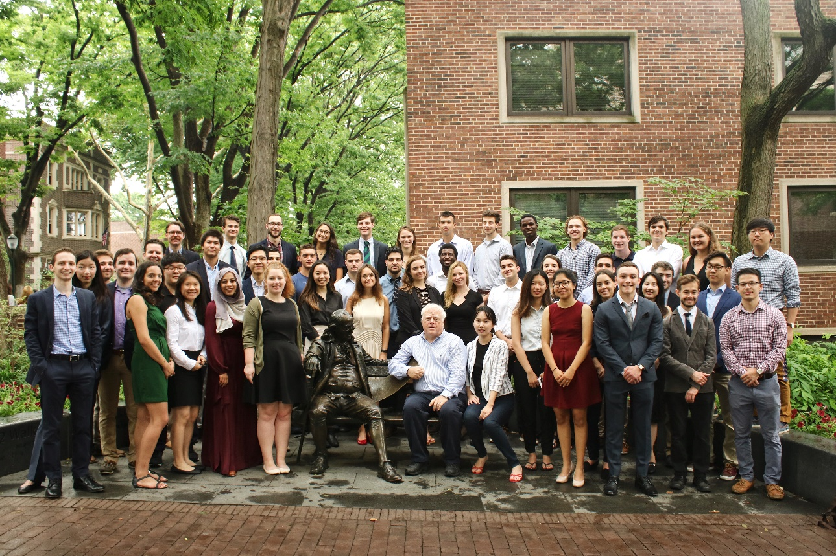
Think Tanks and Civil Societies Program Lauder Institute
Think Tanks and Civil Societies Program

